Slide 1
JOURNEY SCRAPBOOK
Shruti Katyal

Slide 2
Power BI
Power BI is a Microsoft business intelligence and data visualization tool. It helps users connect to data sources, create interactive reports and dashboards, and share insights.
Key features include data connectivity, transformation, visualization, sharing, and mobile access. It's widely used for data analysis and decision-making in organizations.
It allows users to connect to a wide range of data sources, including databases, cloud services, Excel spreadsheets, and more. It supports both on-premises and cloud-based data.
It includes a data modeling feature where users can create relationships between different tables of data, define calculated columns and measures, and build a data model that supports complex analyses.

Slide 3
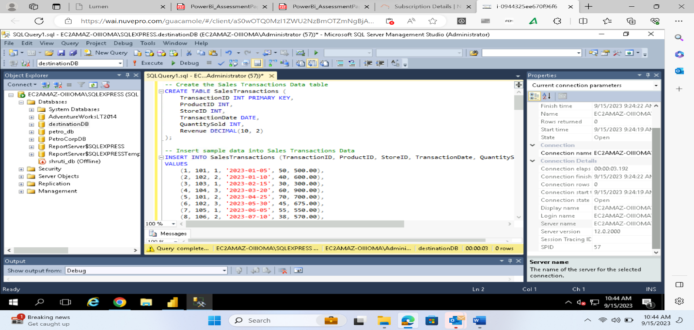
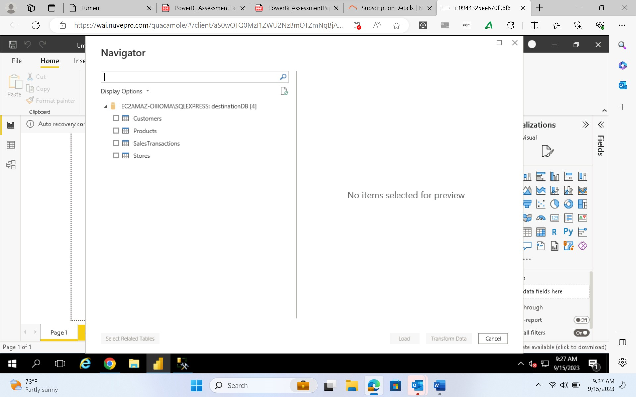
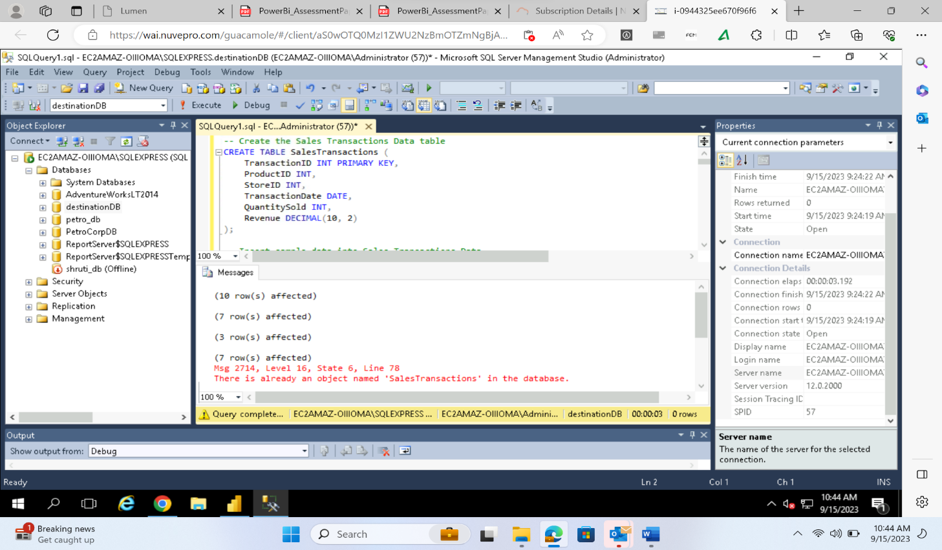
Data Loading in Power BI

Slide 4
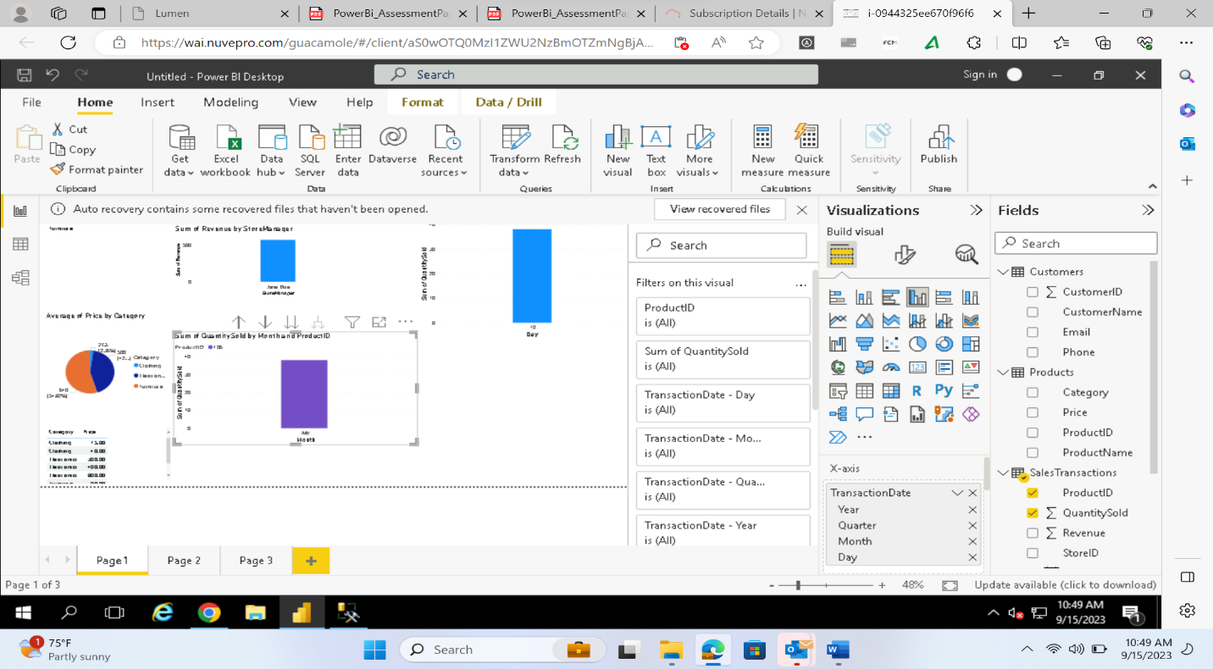
Visualization Filters
Visualization Filters

Slide 5
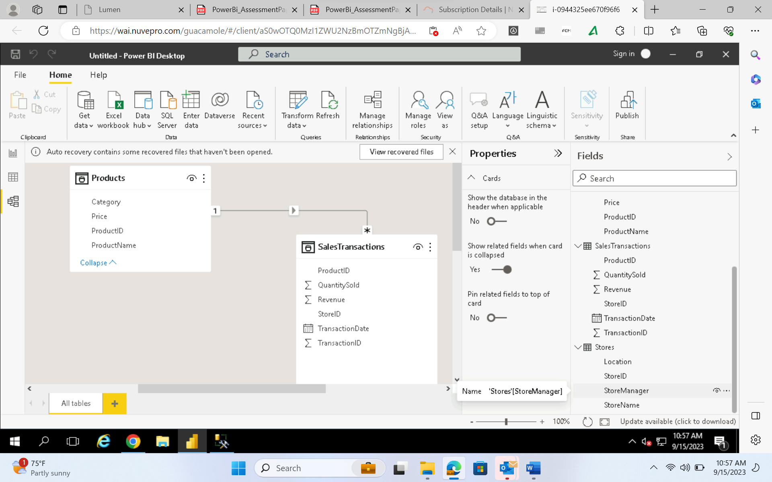
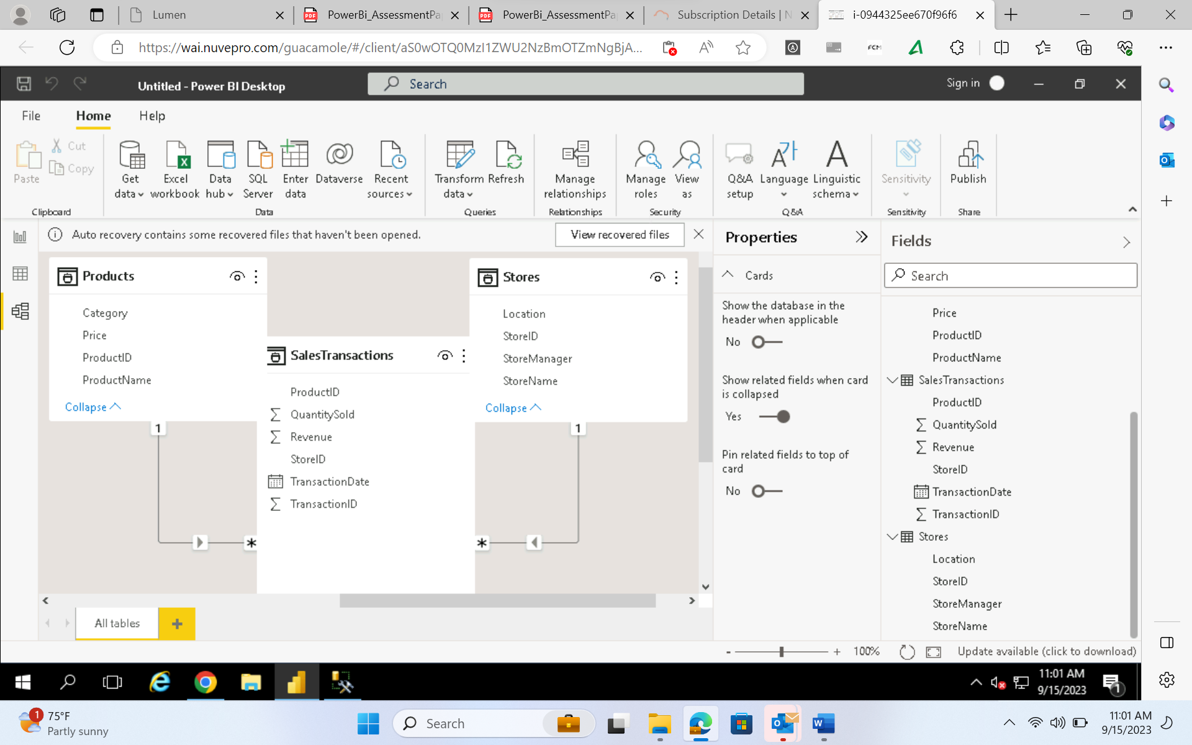
Data Modelling
Data modeling involves:
Structuring Data: Organizing data into tables and defining how they relate to each other.
Relationships: Establishing connections between data tables to enable meaningful queries.
Calculations: Creating calculated fields and measures for deriving insights from the data.
Optimization: Improving data efficiency for faster queries and analysis.
Schema Design: Designing the blueprint for data storage and retrieval.

Slide 6
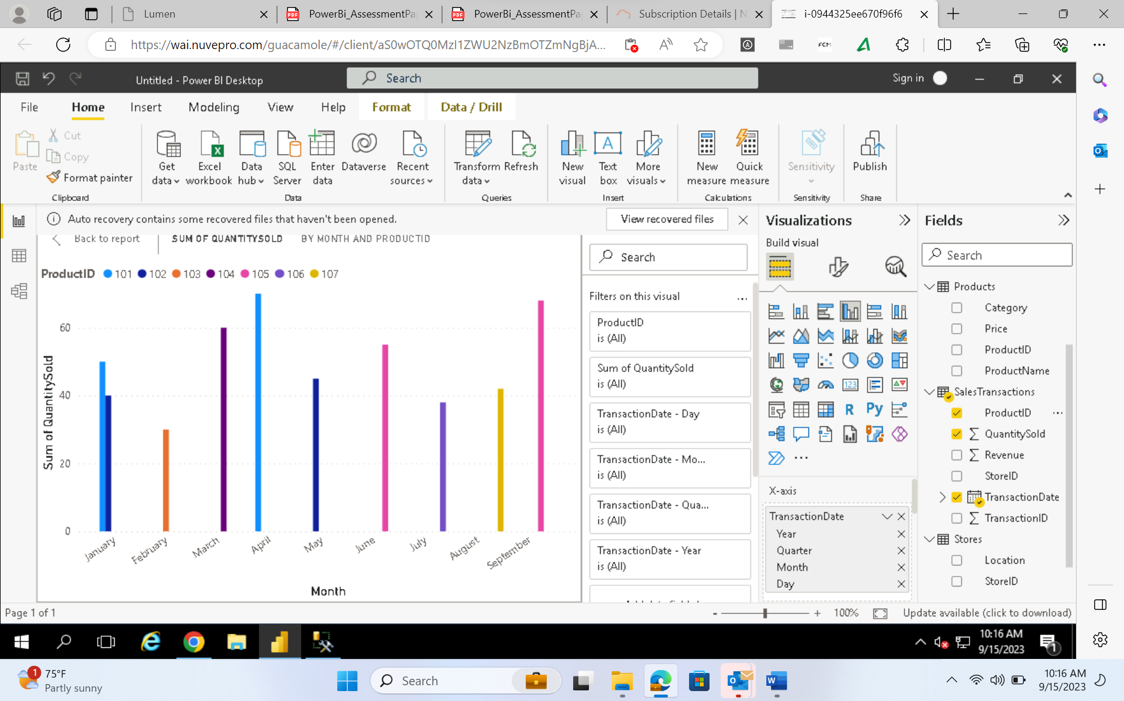
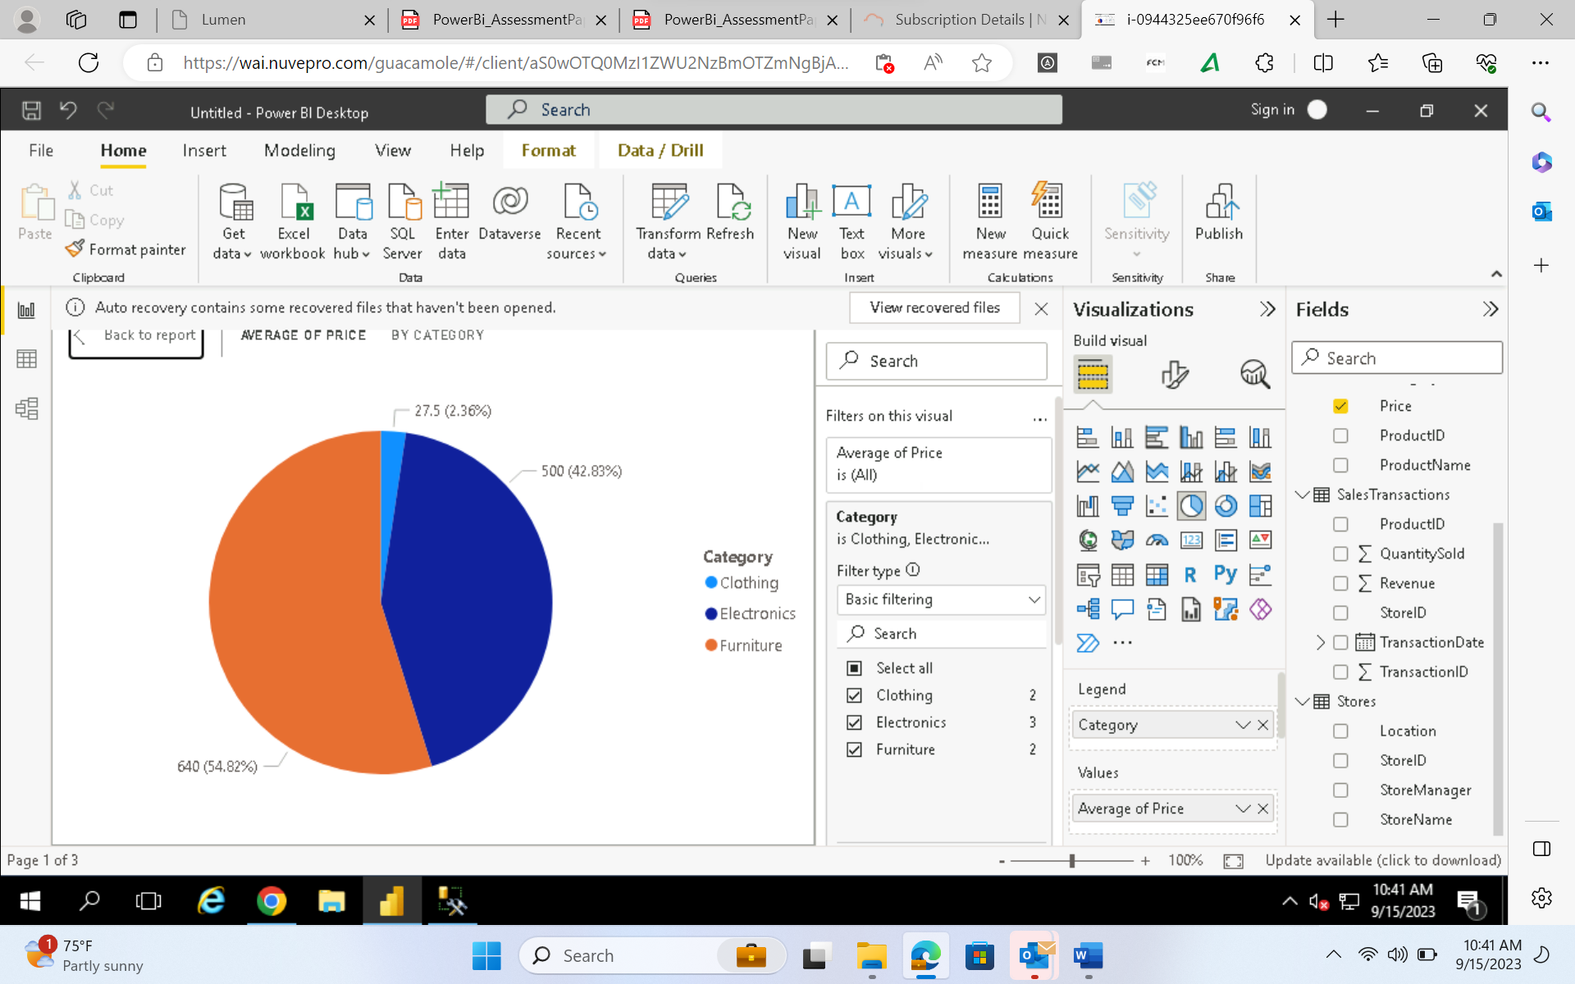
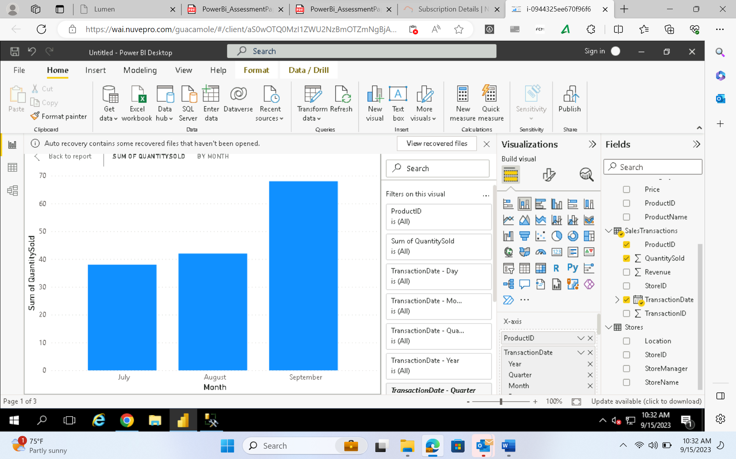
Data Visualization PLOTS

Slide 7




Thank you

